Slide 1

Data Science Committee
Session 1 - Introduction to Data Science
Prepared by: Ashraf Abdulkhaliq

Slide 2

Ashraf Abdulkhaliq Bassuoni
Student at Faculty of Artificial Intelligence (level three), Microsoft Learn Student Ambassador, Data Science Head at IEEE KSB, Data Science Intern at SHAI.
LinkedIn | GitHub | Microsoft Learn | Kaggle | Codeforces

Slide 3
Outline
What’s Data Science?
Importance of Data Science
Data Science Tools
Learning Objectives
Recommended Background
Plan Outline

Slide 4
Outline
What’s Data Science?
Importance of Data Science
Data Science Tools
Learning Objectives
Recommended Background
Plan Outline

Slide 5
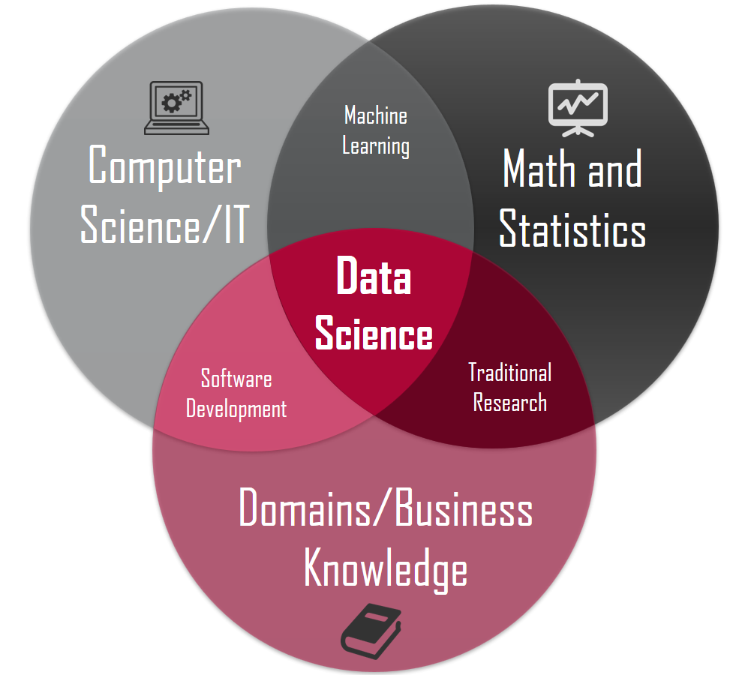
What’s Data Science
Data science is the application of computational and statistical techniques to address or gain insight into some problem in the real world.
Data science = statistics +
data processing +
machine learning +
scientific inquiry +
visualization +
business analytics +
big data + …

Slide 6
Data Science is not Machine Learning
Machine learning involves computation and statistics but has not (traditionally) been very concerned about answering scientific questions.
Machine learning has a heavy focus on fancy algorithms…
Sometimes the best way to solve a problem is just by visualizing the data, for instance.

Slide 7
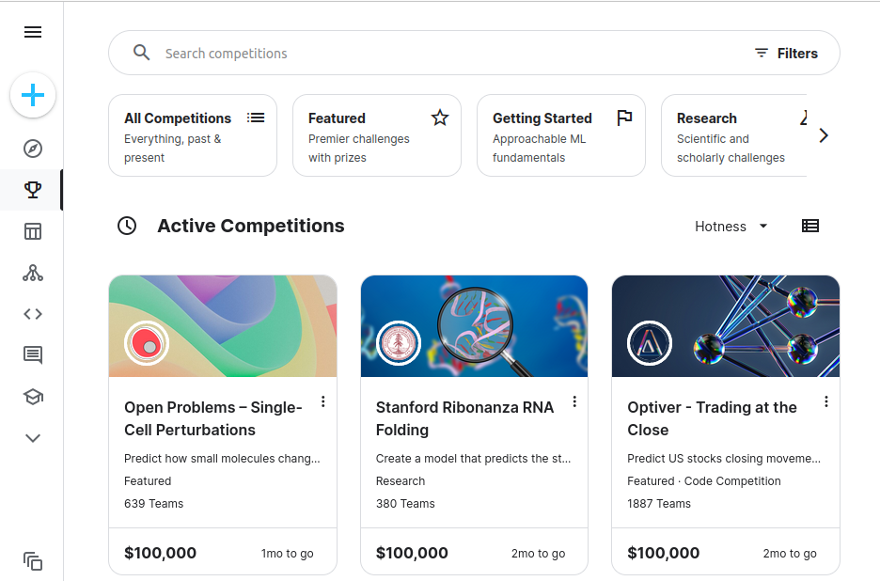
Data Science is not Machine Learning
Data science competitions like Kaggle ask you to optimize a metric on a fixed data set.
This may or may not ultimately solve the desired business/scientific problem.
Data science is the iterative cycle of designing a concrete problem, building an algorithm to solve it, and evaluating what insights this provides for the real underlying question.

Slide 8
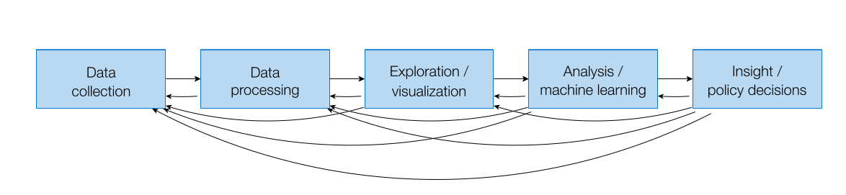
Back to Data Science Pipeline

Slide 9
Outline
What’s Data Science?
Importance of Data Science
Data Science Tools
Learning Objectives
Recommended Background
Plan Outline

Slide 10
Importance of Data Science
Data Science helps brands to understand their customers in a much enhanced and empowered manner.
It allows brands to communicate their story in such a engaging and powerful manner.
Can be applied to almost any industry like education, travel, healthcare, game development, etc...

Slide 11
Outline
What’s Data Science?
Importance of Data Science
Data Science Tools
Learning Objectives
Recommended Background
Plan Outline

Slide 12












Data Science Tools

Slide 13
Outline
What’s Data Science?
Importance of Data Science
Data Science Tools
Learning Objectives
Recommended Background
Plan Outline

Slide 14
Learning Objectives
Understand the end-to-end data science pipeline, from data collection to model deployment.
Be familiar with the programming tools and libraries required to execute different phases of data science projects.
Demonstrate the ability to collect data from a variety of sources, including structured and unstructured data.
Know how to explore and visualize datasets, gaining insights into data distributions, patterns, and outliers.
Be proficient in conducting data analysis using a range of statistical and machine learning techniques.
Create data-driven reports and presentations that convey insights in a clear and compelling manner, addressing the needs of different audiences.

Slide 15
Outline
What’s Data Science?
Importance of Data Science
Data Science Tools
Learning Objectives
Recommended Background
Plan Outline

Slide 16
Recommended Background
Strongly recommend that students have experience with Python, ideally some background of machine learning, in probability and statistics, and linear algebra.

Slide 17
Outline
What’s Data Science?
Importance of Data Science
Data Science Tools
Learning Objectives
Recommended Background
Plan Outline

Slide 18
Plan Outline
1. Data Preparation
Gather
Discover
Cleanse
Transform
Store
2. Machine Learning
Supervise and Unsupervise learning, Hyperparameter tunning, Ensemble Learning, and how to evaluate ML model ...
3. Deployment and Communicating Results

Slide 19
References
http://www.datasciencecourse.org/
https://www.slideshare.net/fvsandoval/introduction-to-data-science-164979975

Slide 20
Thanks
Please keep updated:
https://github.com/kershrita/IEEE-Data-Science

